Slide 1
MLTP DISTRIBUTION · CYPRUS
DUALSENSES
The new generation — Product knowledge
5 pillars · 12 ranges · 55 products
A complete guide to what every product does, with which technology, for which hair and how it is applied.
09 / 2026

Slide 2
THE PHILOSOPHY
Why it is called Dualsenses
Every Dualsenses product works on two levels at once: it delivers an immediate, visible result from the very first use, and builds a long-term improvement in the hair structure with regular use.
IMMEDIATE RESULT
LONG-TERM ACTION
SALON LOGIC
Visible and tangible from the first wash: shine, softness, detangling, volume or frizz control — depending on the range.
With regular use the hair becomes more resilient, the colour holds longer and the scalp returns to balance.
The same actives as the salon services. Home care continues the work done in the chair.
THE SYSTEM IN 3 STEPS
1. SHAMPOO cleanses gently & locks in the colour 2. CONDITIONER / MASK restores & nourishes 3. LEAVE-IN protects & perfects

Slide 3
NAVIGATION
5 pillars, 12 ranges
Simplified navigation: the client finds the need first, then the range.
SCALP CARE
STRUCTURE OPTIMIZING
COLOR CARE
STYLE SUPPORT
MEN'S CARE
Scalp Specialist
Pure Hydration NEW
Color
Ultra Volume
Men
Rich Repair
Color Extra Rich
Just Smooth
Bond Pro
Blondes & Highlights
Curls & Waves
Sun Reflects
TWO TECHNOLOGIES ACROSS THE WHOLE RANGE: microPROtec complex in every product · FadeStop Formula in every shampoo

Slide 4
TECHNOLOGY
The two technologies that unite the range
microPROtec complex
FadeStop Formula
An active-delivery system. It distributes the actives quickly and evenly along the whole hair length, so the result is visible and tangible from the first use — while at the same time protecting against colour fade.
In every Dualsenses shampoo. It actively protects against colour fade at every wash — even in the ranges that are not colour-specific. Coloured hair keeps its intensity and shine for longer.
WHAT THIS MEANS FOR THE CLIENT
Whichever range they choose, their colour is protected.
The result shows immediately — they do not have to wait weeks.
The ranges combine with each other without conflict.
* Excluded from FadeStop: Blondes & Highlights Purple Toning Shampoo and Scalp Specialist Sensitive Foam Shampoo.

Slide 5
TECHNOLOGY
The active of each range
On top of the horizontal technologies, every range has its own signature active ingredient.
Scalp Specialist
Panthenol + a specific active per product
white tea, red algae, sage, caffeine, menthol, Octopirox®, Zinc-PCA
Pure Hydration
Hemisqualane + Panthenol
a light plant lipid for hydration without weight
Rich Repair
IntraLipid
replaces the lipids lost inside the hair
Bond Pro
Inter-Amino-Bond-Builder
amino acids, peptides, red & brown algae extracts
Color
Luminescine
converts invisible UV light into visible light — striking colour brilliance
Color Extra Rich
Luminescine
same technology, richer texture for coarse hair
Blondes & Highlights
Luminescine
brilliance + neutralisation of yellow tones
Sun Reflects
Panthenol + UVA/UVB filters
protection and repair after sun exposure
Ultra Volume
Rice protein
strengthens the hair without weighing it down
Just Smooth
Kukui nut oil
lubricates and seals the cuticle against frizz
Curls & Waves
Hydrolyzed starch + glycerin NEW
replaces milk protein — better curl bundling
Men
Guarana + caffeine
energises the scalp, refreshes

Slide 6
PRODUCT FORMATS
What each format does
The same formats repeat across every range. Once the client understands the format, they can choose within any range.
SHAMPOO
CONDITIONER
60SEC TREATMENT
INTENSIVE CONDITIONING SERUM
Cleanses gently and prepares the hair. Always contains FadeStop Formula.
Detangles, closes the cuticle, reduces breakage while combing.
Intensive mask. Delivers its maximum result in just 60 seconds.
Intensive deep-action ampoule. The strongest repair step of the range.
Daily
Every wash · 1–2 minutes
1–2 times a week
Weekly · 5–10 minutes
SERUM SPRAY
6 EFFECTS SERUM
LEAVE-IN SPRAY / FLUID
OIL / BALM / BOOSTER
Two-phase leave-in. Detangles, protects and prepares for styling.
Concentrated serum with 6 simultaneous benefits on lengths and ends.
Light daily protection: hydration, heat protection, anti-static action.
Finishing and targeted action: shine, control, bond reinforcement.
On damp hair · do not rinse
Damp or dry hair
Daily
On dry or damp hair

Slide 7
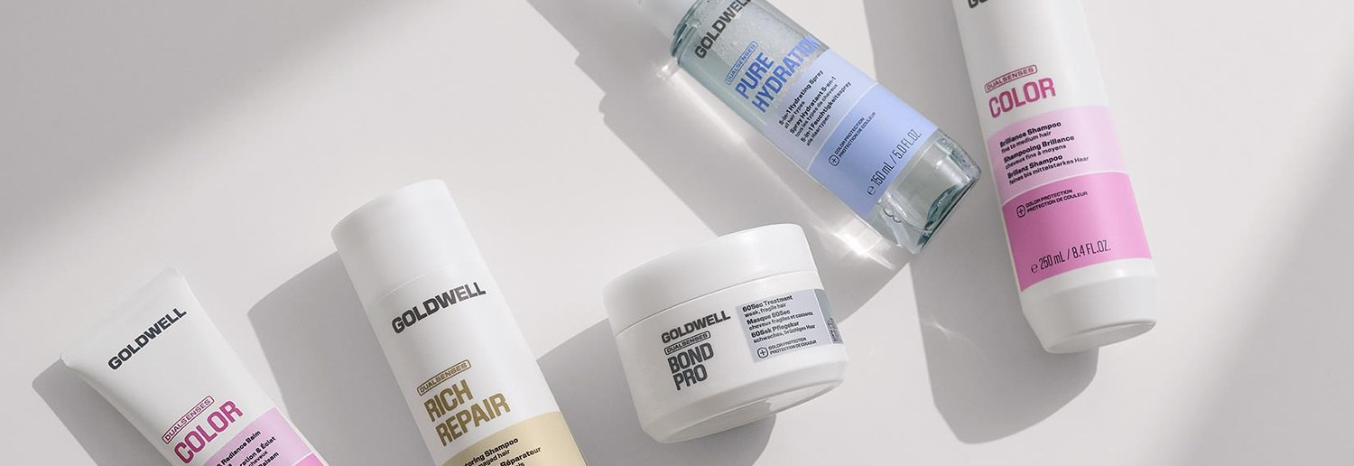
NEW GENERATION 2026
What changes in the formula
SERUM SPRAY — CLEAR PHASE
CURLS & WAVES — NEW TECHNOLOGY
CURLS & WAVES — NEW LEAVE-IN SPRAY
In Rich Repair and Curls & Waves the lower phase changes from milky to clear. A more modern texture, a lighter result, the same performance.
Hydrolyzed starch and glycerin replace milk protein. Better hold, curl alignment and a perfect spiral shape.
A new single-phase, clear formula with improved performance in holding the curl.
COLOR & COLOR EXTRA RICH — SHARED FRAGRANCE
MEN — NEW FRAGRANCE
ULTRA VOLUME — UNIFIED FRAGRANCE
The Color Extra Rich range now carries the same fragrance as Color. A unified experience, while keeping the differentiation by hair type.
The Men range is modernised with a new, fresh fragrance closer to current market trends.
The Bodifying Spray now carries the core fragrance of the range, for consistency across the whole line.

Slide 8
NEW GENERATION 2026
What changes in the range & the packaging
NEW RANGE: PURE HYDRATION
NEW 2D DESIGN
Pure hydration without repair and without weight — the need that was missing from the line-up.
A bolder approach to logo and typography.
A stronger presence for the “Dualsenses” name.
Same colour codes — easy recognition on the shelf.
BLONDES IN ONE PLACE
From a metallic to a more modern, matt finish.
The colour-giving products for blondes move into the Blondes & Highlights range as Purple Toning Shampoo & Conditioner. One place for all blonde care.
Text restructured for better readability.
MEN: NEW PACK COLOUR
NEW NAMES IN CURLS & WAVES
Bottle and cap in a modern light grey — easier to recycle and better aligned with the pastel tones of the new identity, without losing its masculine character.
Renamed on a “bundling” logic, so it is clear what the product does and it stands apart from the new Pure Hydration.

Slide 9
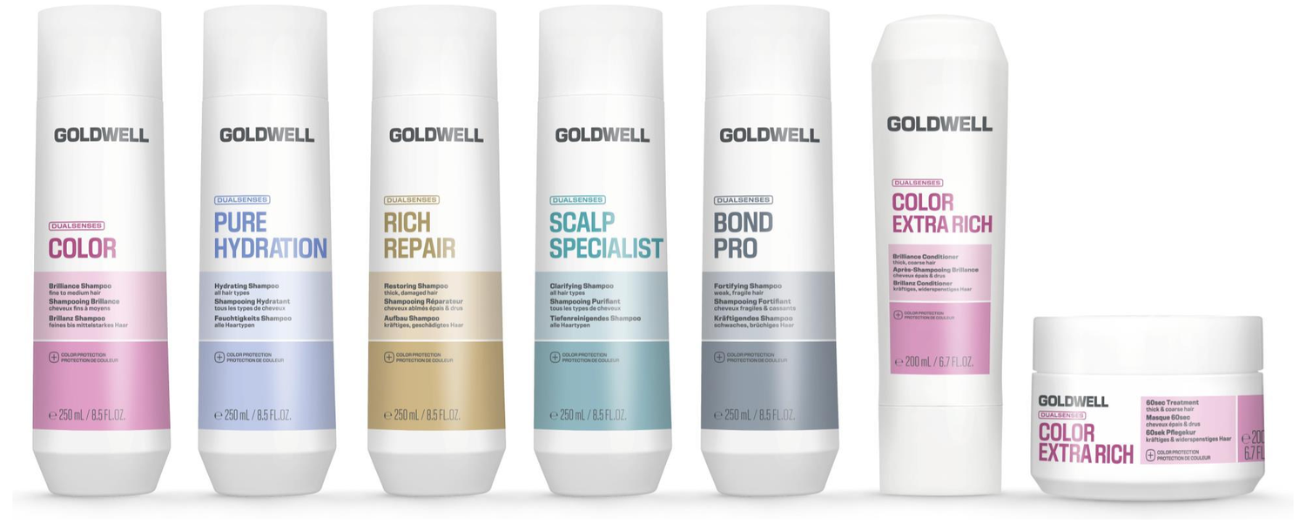
THE 12 RANGES
Product by product

Slide 10
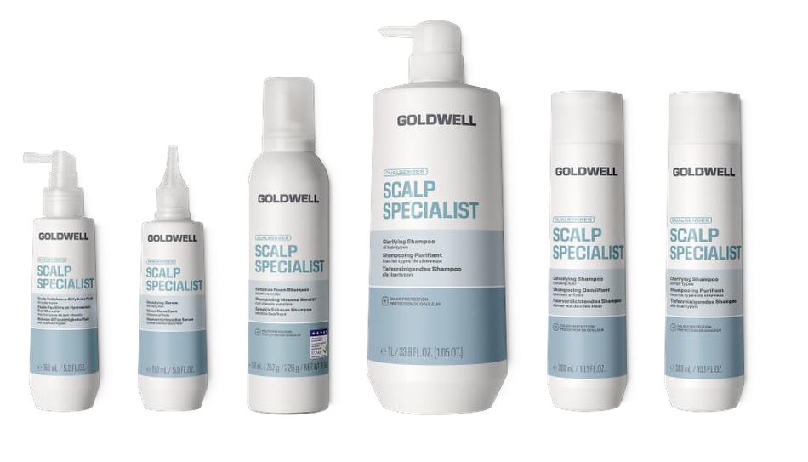
SCALP CARE
Scalp Specialist
An instantly balanced scalp, with dermatologically approved solutions tailored to the need.
TECHNOLOGY Panthenol + a targeted active per product
WHO IT'S FOR Oiliness, dandruff, sensitivity, dryness, thinning — care starts at the scalp.
Clarifying Shampoo
Anti-Dandruff Shampoo
Sensitive Foam Shampoo
Densifying Shampoo
Deep cleansing. Removes styling residue, oil and mineral build-up without dehydrating. With white tea extract.
With Octopirox® and Zinc-PCA. Visibly reduces dandruff and prevents it from returning with regular use.
In a foam format, extremely gentle. For a sensitive scalp that is easily irritated. Cleanses without any tightness.
With caffeine and panthenol. Activates and refreshes the scalp — hair looks and feels denser.
Anti-Hair Loss Serum
Densifying Serum
Rebalance & Hydrate Fluid
Leave-in with caffeine, panthenol and willow bark extract. Visibly strengthens the fibre to reduce the risk of breakage.
Leave-in for visible density. Works on the scalp, no rinsing, daily use.
With red algae extract. Immediate relief from dryness and tightness, restores the moisture balance. Do not rinse.
The Sensitive Foam Shampoo does not contain FadeStop Formula.

Slide 11
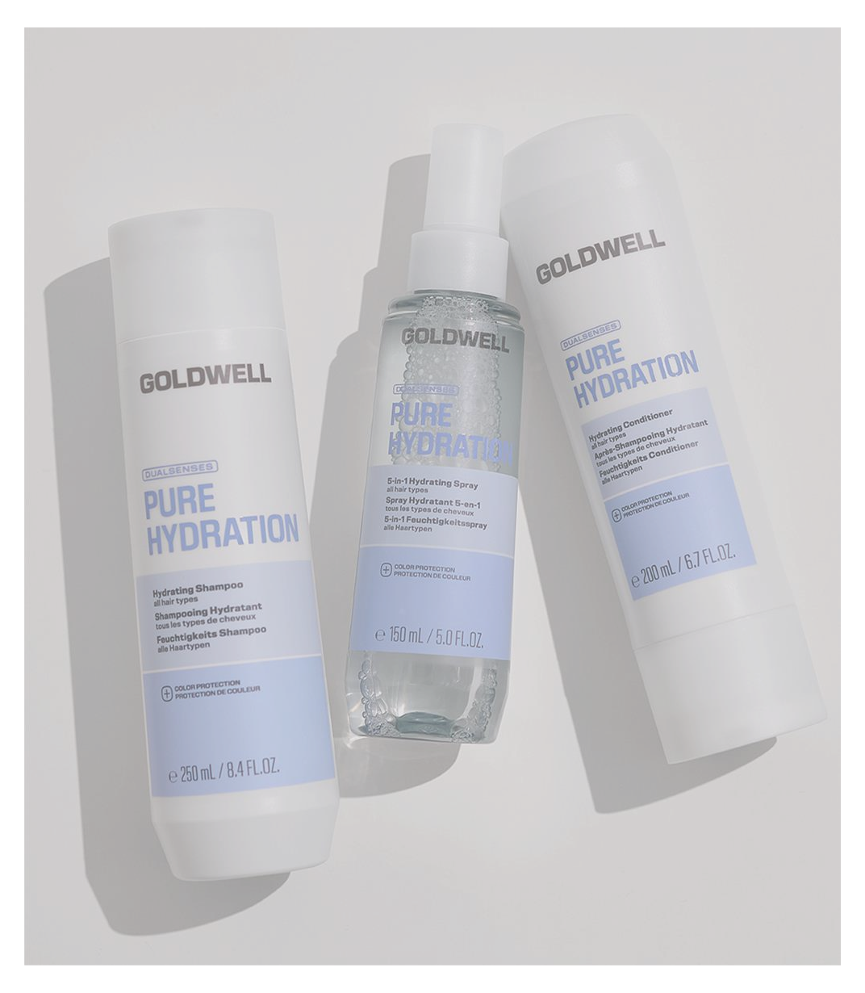
STRUCTURE OPTIMIZING · NEW RANGE
Pure Hydration
Instant hydration and a weightless hair feel.
TECHNOLOGY Hemisqualane + Panthenol
WHO IT'S FOR Dehydrated hair that is not actually damaged — and every client who fears that hydration will weigh their hair down.
Hydrating Shampoo
Hydrating Conditioner
5-in-1 Hydrating Spray
Instant hydration from the first wash.
Improved hair elasticity.
Instant, long-lasting hydration with regular use.
Detangles instantly and controls flyaways.
Hydrates, nourishes and detangles instantly.
Immediate anti-static effect.
Heat protection up to 230°C / 446°F.
Over 80% of participants confirmed an immediate feeling of hydration without the hair feeling heavy. Test D/USA, 154 stylists, 2025.

Slide 12
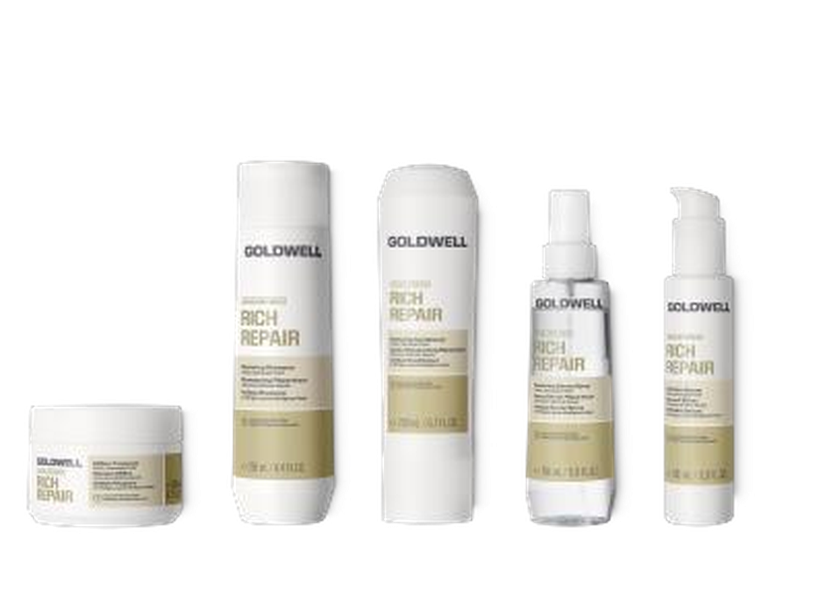
STRUCTURE OPTIMIZING
Rich Repair
Instant repair, reversing a year of damage.
TECHNOLOGY IntraLipid
WHO IT'S FOR Dry, stressed, chemically loaded hair. The classic rescue for damaged hair.
Restoring Shampoo
Restoring Conditioner
60Sec Treatment
Instantly reconstructs and reawakens the natural shine. With FadeStop at every wash.
Instantly increases combability and effectively reduces breakage.
Reconstructs the fibre up to 100% in 60 seconds. Action from within.
6 Effects Serum
Restoring Serum Spray
Intensive Conditioning Serum
Six benefits together: shine, softness, elasticity, anti-frizz, healthy ends, less breakage.
Leave-in. Gives softness and shine, detangles and makes styling easier.
Intensive deep-repair ampoule for the most damaged hair.
IntraLipid: replaces the lipids lost inside the hair and repairs the lipid structure of the cuticle.

Slide 13
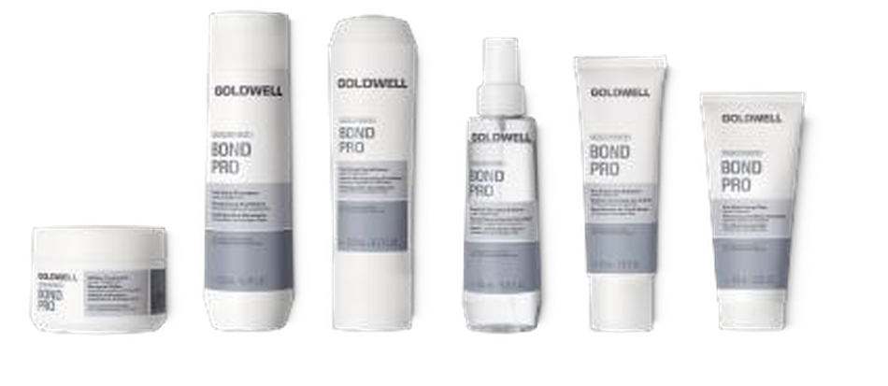
STRUCTURE OPTIMIZING
Bond Pro
Up to 99% less breakage and up to 20× stronger, more resilient hair.
TECHNOLOGY Inter-Amino-Bond-Builder
WHO IT'S FOR Fine, fragile hair that breaks. Hair after lightening, colouring or heat stress.
Pre-Wash Cortex Filler
Fortifying Shampoo
Fortifying Conditioner
The first step before washing. Fills the gaps in the cortex so the whole routine works better.
Instantly delivers care and structure. Strengthens weak strands at every wash.
Visibly reduces breakage and protects against mechanical damage while combing.
Repair & Structure Spray
60Sec Treatment
Day & Night Bond Booster
Leave-in. Instant, long-lasting cuticle protection and heat protection.
Strengthens the fibre up to 100% in 60 seconds, without weighing it down.
Intensive leave-in reinforcement. Stabilises the bond network day and night.
Amino acids and peptides penetrate the cortex, while red and brown algae extracts form new ionic bonds with the remaining hair proteins.

Slide 14
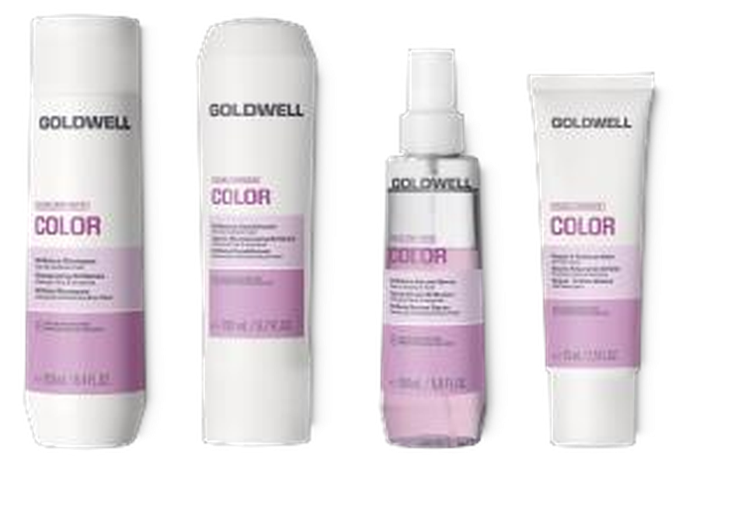
COLOR CARE
Color
Keeps hair colour vibrant for up to 100 days.
TECHNOLOGY Luminescine
WHO IT'S FOR Coloured hair, fine to medium texture. The core choice for every client with colour.
Brilliance Shampoo
Brilliance Conditioner
Brilliance Serum Spray
Instantly brings out colour luminosity. With FadeStop it minimises fading with every use.
Detangles and closes the cuticle so the colour reflects more light.
Leave-in. Shine, detangling and colour protection before styling.
Repair & Radiance Balm
Intensive Conditioning Serum
Leave-in balm. Boosts colour vibrancy, reduces split ends and protects against UV.
Intensive ampoule. Keeps salon colour vibrant for up to 22 washes.
Luminescine: converts non-visible UV light into visible light, for striking colour brilliance.

Slide 15
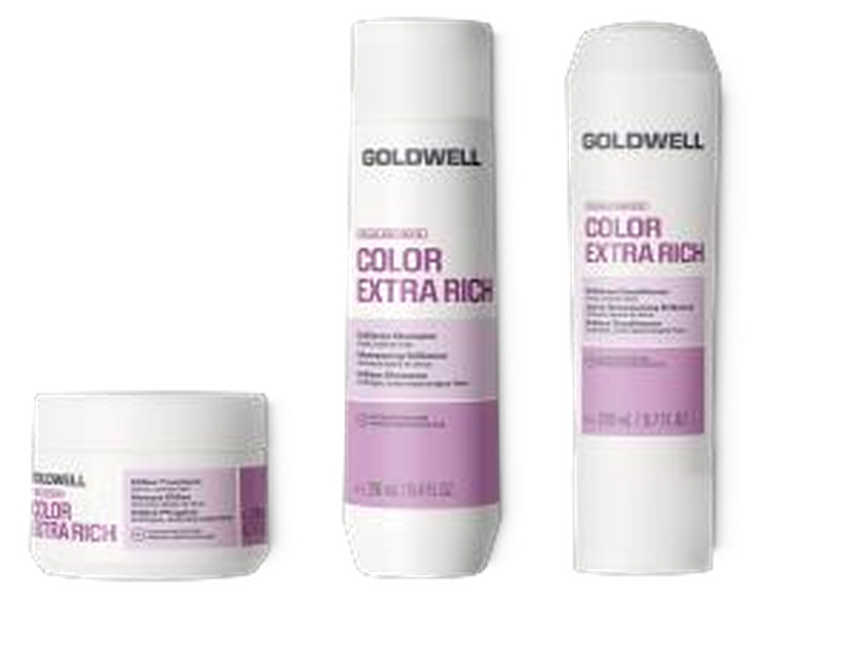
COLOR CARE
Color Extra Rich
Keeps colour vibrant for up to 100 days — with richer nourishment.
TECHNOLOGY Luminescine
WHO IT'S FOR Coloured hair with thick, dense or coarse texture that needs more nourishment than the Color range.
Brilliance Shampoo
Brilliance Conditioner
60Sec Treatment
Intensive Conditioning Serum
The same colour protection as the Color range, in a richer formula for demanding hair.
Intensive nourishment and control on coarse hair, without losing the colour brilliance.
A one-minute intensive mask — nourishment and colour protection in 60 seconds.
Intensive ampoule for deep nourishment and maximum colour longevity.
New: Color and Color Extra Rich now share the same colour code and the same fragrance — one unified, stronger colour care block on the shelf.

Slide 16
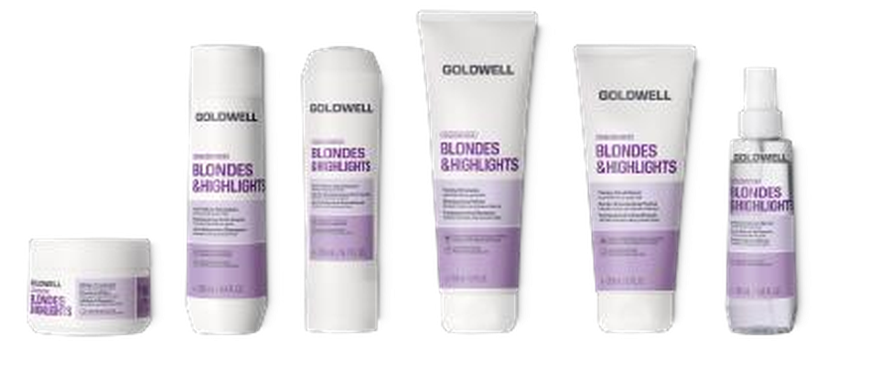
COLOR CARE
Blondes & Highlights
Instantly reduces yellow tones, keeping blonde cool for longer.
TECHNOLOGY Luminescine
WHO IT'S FOR Blonde, lightened, highlighted and grey hair.
Anti-Yellow Shampoo
Anti-Yellow Conditioner
Purple Toning Shampoo
Purple Toning Conditioner
Neutralises unwanted yellow tones at every wash.
Completes the shampoo — a cool result and detangling together.
With direct pigments. 2 minutes for a light refresh, up to 5 for intensive toning. Wear gloves.
The same logic as the shampoo, with extra nourishment. Ideal between colour appointments.
Brilliance Serum Spray
60Sec Treatment
Intensive Conditioning Serum
Leave-in. Shine and protection for fragile, lightened hair.
Intensive mask with anti-yellow action in 60 seconds.
Intensive ampoule for lightened hair that needs deep repair.
The Purple Toning Shampoo does not contain FadeStop Formula. The processing time determines the intensity of the toning.

Slide 17
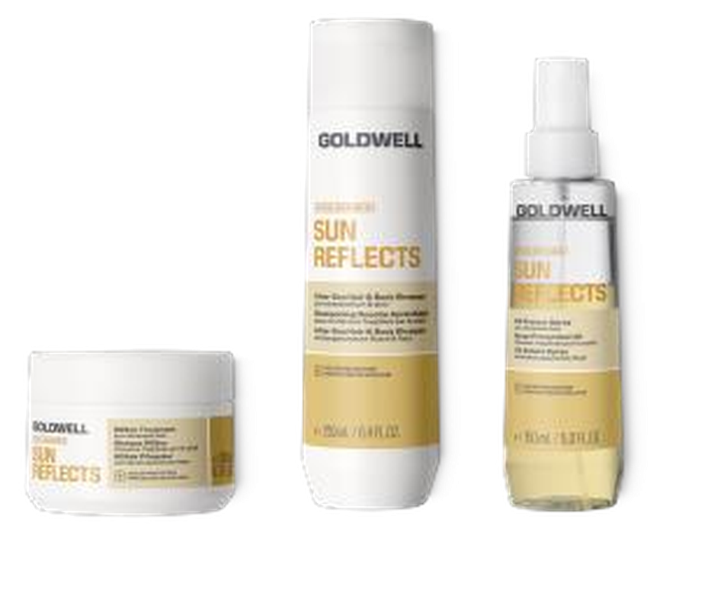
COLOR CARE
Sun Reflects
Instantly protects and regenerates sun-stressed hair, in just one minute.
TECHNOLOGY Panthenol + UVA/UVB filters
WHO IT'S FOR Summer, sea, pool. Essential for coloured and blonde hair in the sun.
After-Sun Hair & Body Shampoo
UV Protect Spray
60Sec Treatment
Cleanses hair and body in one step.
Effectively removes salt, chlorine and residue from pool and sea water.
Leave-in. Instant protection from sun, chlorine and sea water.
Protects the colour from UV fading and prevents moisture loss.
Instantly regenerates the hair in 60 seconds.
Replenishes the moisture that was lost and restores softness and shine.

Slide 18
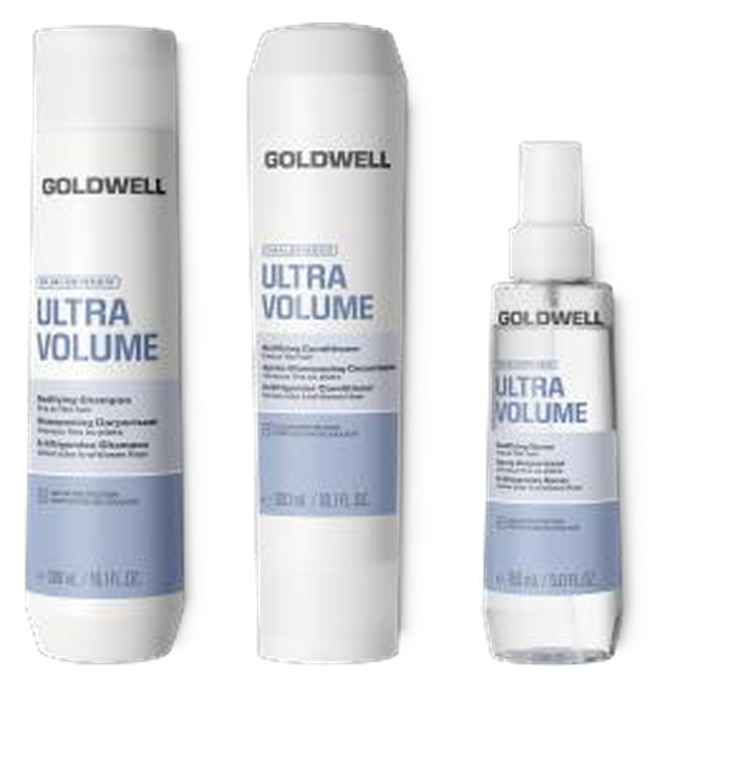
STYLE SUPPORT
Ultra Volume
Instant volume for up to 2× fuller hair.
TECHNOLOGY Rice protein
WHO IT'S FOR Fine, limp hair with no body — that cannot take heavy products.
Bodifying Shampoo
Bodifying Conditioner
Bodifying Spray
Cleanses and gives instant body from the root, without weighing down.
Detangles and hydrates while keeping the volume — care without weight.
Leave-in for visible and touchable fullness.
New: it now carries the core fragrance of the range.

Slide 19
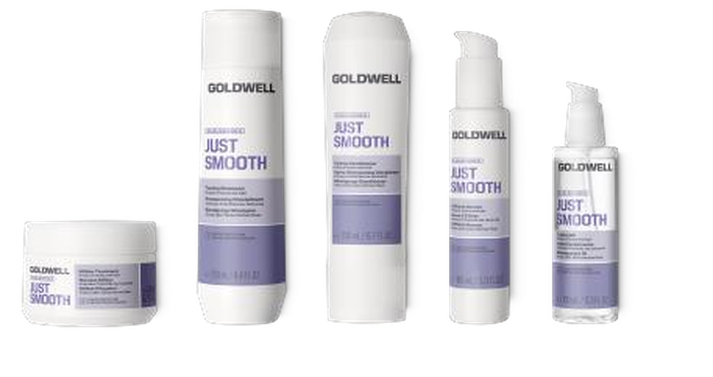
STYLE SUPPORT
Just Smooth
Instantly reduces and controls frizz for up to 72 hours.
TECHNOLOGY Kukui nut oil
WHO IT'S FOR Unruly, frizz-prone hair — especially in humidity.
Taming Shampoo
Taming Conditioner
60Sec Treatment
Cleanses and starts frizz control from the very first step.
Softness, control and easy detangling on difficult hair.
Intensive smoothing mask in 60 seconds — for visibly straighter results.
6 Effects Serum
Taming Oil
Intensive Conditioning Serum
Six benefits on lengths and ends, with the focus on smoothing and shine.
Finishing oil. Intense shine and humidity resistance, without a greasy feel.
Intensive ampoule for deep, long-lasting smoothing and control.

Slide 20
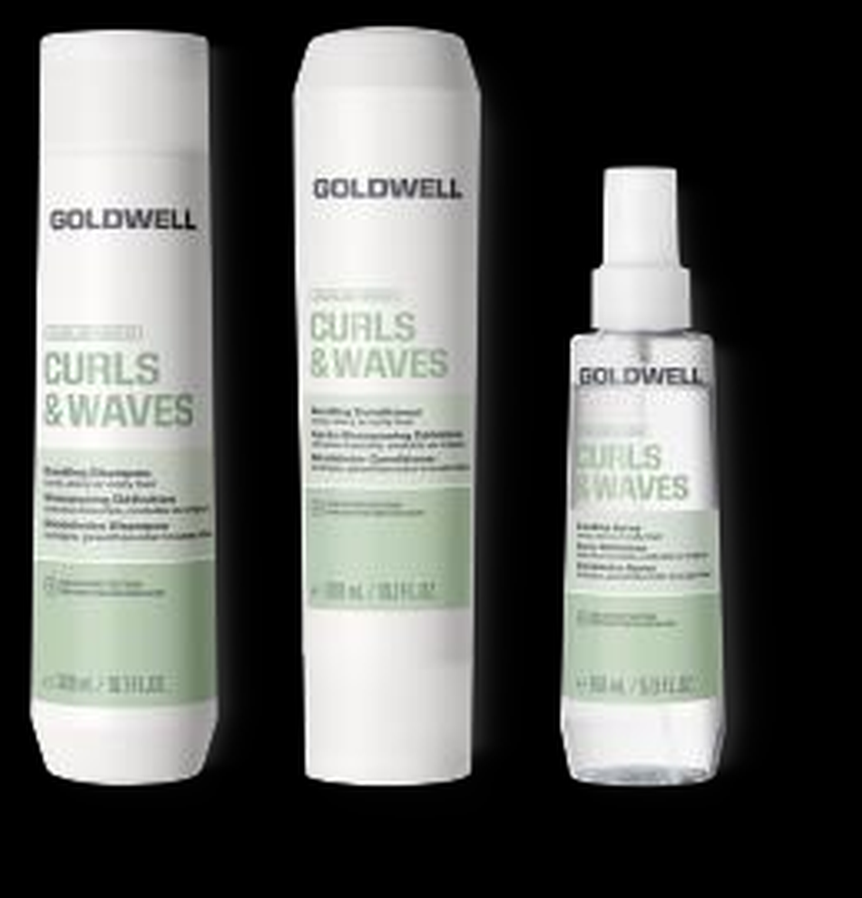
STYLE SUPPORT
Curls & Waves
Instantly hydrates and defines the curls.
TECHNOLOGY Hydrolyzed starch + glycerin (NEW)
WHO IT'S FOR Curly, wavy and permed hair that needs shape and hydration together.
Bundling Shampoo
Bundling Conditioner
Bundling Spray
Intensive Conditioning Serum
Cleanses and hydrates, while it starts to gather the curl into clean spirals.
Hydration and elasticity, with curl definition and no weight.
Leave-in. New single-phase, clear formula: better hold, alignment and spiral shape.
Intensive ampoule. Improves curl elasticity for up to one week.
New technology: hydrolyzed starch and glycerin replace milk protein. The new “bundling” names state the action clearly and set the range apart from the new Pure Hydration.

Slide 21
MEN'S CARE
TECHNOLOGY
Men
Guarana + caffeine
Care in one step — for hair and body.
WHO IT'S FOR The male client who wants one product, fast, with no compromise on quality.
Hair & Body Shampoo
WHAT TO REMEMBER
Cleanses and refreshes hair and body at the same time. Guarana and caffeine energise the scalp.
New fragrance, fresher and more modern.
New light grey pack, easier to recycle.
For more targeted needs, the male client is now directed to the other ranges:
· Dandruff or sensitivity → Scalp Specialist
· Thinning → Scalp Specialist Densifying
· Damage → Bond Pro or Rich Repair

Slide 22
FRAGRANCES
Fragrance description · 1/2
The fragrance is part of the experience — and often the reason the client buys again.
RANGE
TOP
HEART
BASE
DESCRIPTION
Color
White peach
Lily of the valley
Musks
A cheerful fragrance with fruity freshness and delicate white florals, embraced by a rich, musky-woody base.
Color Extra Rich
Blondes & Highlights
Orange
Rose
Iris
A floral, rosy fragrance with fresh orange and mandarin and a green touch, evolving into a warm musky-woody base.
Sun Reflects
Peach
Tiare · white flower
Almond milk
A soft, fruity fragrance combining peach and nectarine with sunny frangipani, ending in a powdery woody musk base.
Scalp Specialist
Grapefruit
Peony
Sandalwood
A revitalising fragrance with bright green citrus notes, a transparent floral heart and a soft woody musk base.
Pure Hydration
Ozonic notes
Cherry blossom
Heliotrope
A fresh and bright fragrance with cool, watery notes and a rich floral heart, melting into a soft veil of white musk.
Rich Repair
Mandarin
Rose
Patchouli
An elegant oriental fragrance with a juicy citrus opening, notes of rose and jasmine, sensual patchouli and musk.

Slide 23
FRAGRANCES
Fragrance description · 2/2
The fragrance is part of the experience — and often the reason the client buys again.
RANGE
TOP
HEART
BASE
DESCRIPTION
Bond Pro
Tea
Gardenia
Sandalwood
A bright fragrance with juicy peach and radiant bergamot, evolving into tea leaves and white florals with osmanthus, on a creamy musky base.
Ultra Volume
Green leaves
Marine notes
White musks
A fresh, floral fragrance with bright lemon peel notes and green nuances, on a warm base of amber and woods.
Just Smooth
Blackcherry
Lily of the valley
Sandalwood
A soft and sensual fragrance with green pear and berry notes, a transparent floral heart and a creamy musky-woody base.
Curls & Waves
Pineapple
Rose
Patchouli
A feminine floriental fragrance with bright lemon notes and juicy tropical fruits, lit by rose, jasmine and iris.
Men
Apple
Geranium
Amber
A radiant and masculine fragrance with fresh apple, pineapple and grapefruit notes, a floral aromatic heart and a deep base of amber woods.

Slide 24
AT THE CHAIR
From the need to the range
The fastest way to choose: ask what bothers the client and follow the line.
“It breaks and I have split ends”
→
Bond Pro
“It's dry and damaged”
→
Rich Repair
“It's just dehydrated, not damaged”
→
Pure Hydration
“My colour fades quickly”
→
Color / Color Extra Rich
“My blonde turns yellow”
→
Blondes & Highlights
“It itches / I have dandruff / it gets oily”
→
Scalp Specialist
“I'm seeing thinning”
→
Scalp Specialist Densifying
“It has no volume, it's limp”
→
Ultra Volume
“It frizzes in humidity”
→
Just Smooth
“I want my curls to stand out”
→
Curls & Waves
“I'm at the sea all summer”
→
Sun Reflects
“I want something quick, one product”
→
Men

Slide 25
RECOMMENDATION
The routine you recommend
Three levels of commitment. Start with what suits the client and build from there.
ESSENTIAL
COMPLETE
INTENSIVE
2 products
3–4 products
5+ products
Shampoo of the range
Shampoo
Everything above
Conditioner of the range
Conditioner
Intensive Conditioning Serum weekly
60Sec Treatment 1–2×/week
Targeted booster / oil / balm
Leave-in spray
The minimum correct care. Already a better result than what the client uses today.
The recommendation that gives a visible difference within 2–3 weeks. This is where you should aim.
For very damaged hair, or after an intense chemical service.
The ranges combine: e.g. Scalp Specialist shampoo + Rich Repair mask, or a Bond Pro routine + Blondes & Highlights toning once a week.

Slide 26
DUALSENSES
Immediate result. Long-term difference.
Thank you.
MLTP DISTRIBUTION · CYPRUS

